Slide 1
Degrees in the Physical Sciences and Engineering

Slide 2
Resources to Look through
https://firefly.sevenoaksschool.org/physics-dept/ib/great-extra-stuff
Physics Resources
http://www.iop.org/publications/iop/2012/file_57522.pdf
https://www.topuniversities.com/courses/physics-astronomy/guide#tab=0
Engineering Resources
http://www.theiet.org/students/studying-engineering/
https://www.raeng.org.uk/education/what-is-engineering
http://www.tomorrowsengineers.org.uk/media/1947/te-booklet-web-from-idea-to-career.pdf
http://i-want-to-study-engineering.org/
UCAS
https://www.ucas.com/

Slide 3
Degrees in Physics
Degrees in Engineering
Degrees in Natural Sciences and other Physical Sciences
Other considerations when applying
How to best improve your chances for success.

Slide 4
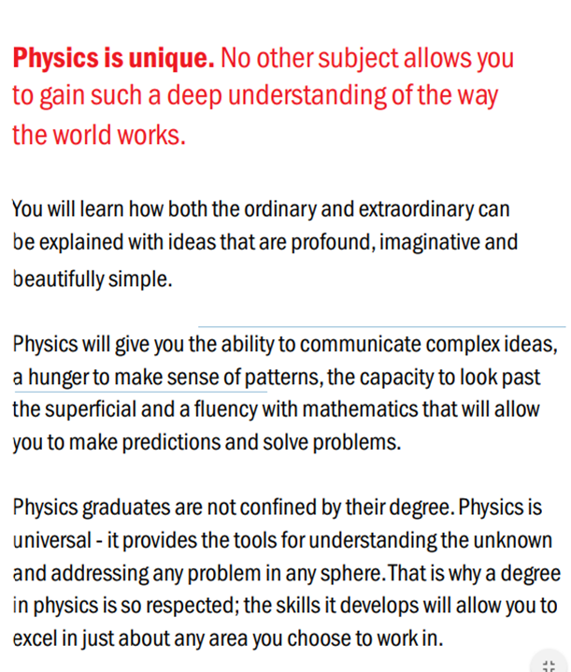
Physics Degrees
Usually either 3 (BSc) or 4 years (MSc) long.
Highly transferable degree which has applications in a range of careers – e.g. research, finance, data analysis, computing, management.

Slide 5
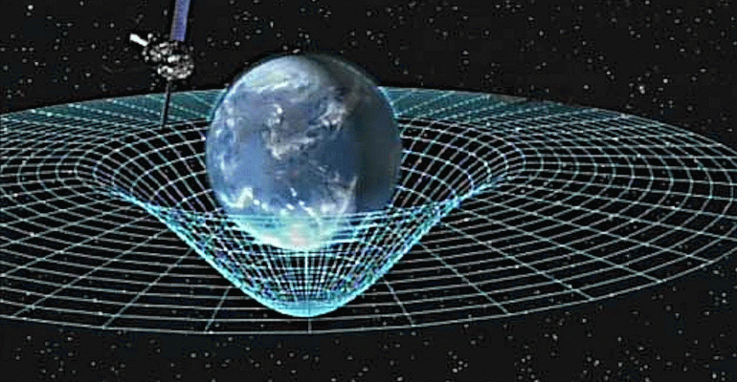
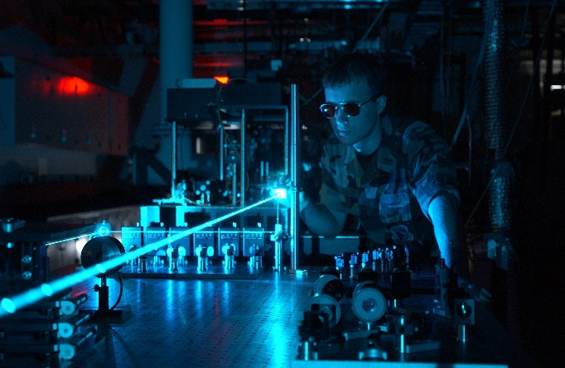
Physics Degrees
Usually either 3 (BSc) or 4 years (MSc).
Typical Compulsory Modules:
Particle physics
Relativity
Lasers
Solid-state physics
Waves and optics
Statistical physics
Mechanics
Quantum physics
Nuclear and atomic physics
Electromagnetism
Oscillations
Thermodynamics
Typical Optional Modules:
Astrophysics
Cosmology
Biophysics
Applied physics
Atmospheric physics
Environmental physics
Geophysics

Slide 6
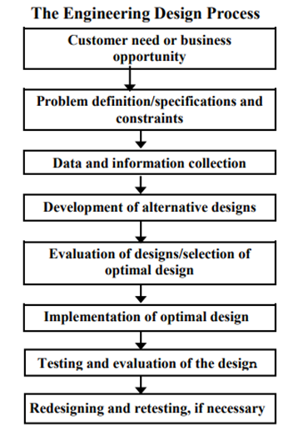
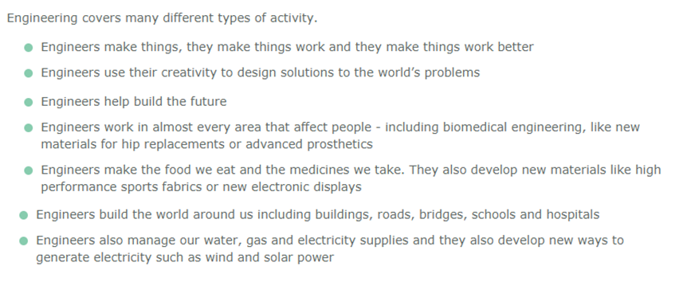
Engineering Degrees
What is engineering?
Engineering degrees are mostly about building the skill set to enter the engineering workforce! There is considerable overlap between an engineering degree and a Physics degree.

Slide 7
Engineering Degrees – Types of Engineering
General
Mechanical
Civil
Electrical/ Electronic
Aeronautical
Chemical
Biomedical
Computer
And plenty more! (Marine, Energy, Materials, Manufacturing, Systems, Environmental)

Slide 8
Engineering Degree Structure
Again, usually 3 (BEng) or 4 years (MEng).
To become a qualified Chartered Engineer (a well recognised qualification), you must have completed a Masters Level degree in an Engineering discipline, followed by several years work experience.
Because of this, some institutions only offer the Masters Level course, so check UCAS!

Slide 9
Alternative Options
There are also many other options available:
Natural Sciences
Mathematics
Computer Science (software engineering, programming)
Materials Science
Geophysics/ environmental physics

Slide 10
Physics, Engineering or something else?
Think about what you most ENJOY, not just what you are best at!
This can be a difficult question to answer. Many graduate employers are very interested in any quantitative degree, so all have excellent career prospects.
Obviously, if you want to be an engineer, choose engineering! To become a Chartered Engineer, you need a Master’s Level degree in Engineering.
If you prefer the theoretical side of Physics, or even practical experiments, then consider a Physics degree. Very transferable to other areas, and you may get to explore some of the more unexplored areas of Physics in greater depth.
If your main interests outside of these areas, perhaps you are interested in pure maths, or enjoy programming, consider other options.

Slide 11
Other options – Year in Industry
Several courses offer a year in Industry as part of their degree program.
These are normally an additional year to the Physics course, but will give you some (paid) work experience with a company in an area of your choosing as part of the program.
Examples include placements with Shell, Mercedes, GSK, Rolls Royce
Can be very useful when applying to your first jobs after graduation – you will already have a year’s experience under your belt over others!
Not offered by all universities, check UCAS.

Slide 12
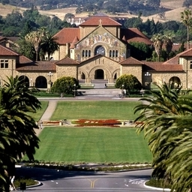
Other options – ERASMUS/ Year Abroad
This can give you the opportunity to study abroad as part of your degree, usually in your 3rd year.
Some courses or universities have language courses available to you, so a year abroad can be very useful in cultivating your language skills, and giving an extra skill for the job market.
ERASMUS is mostly European countries, though there may be year abroad programs in other countries (USA, Australia, Canada, Japan).
Generally these will count as part of the program, so will not be an extra year of study.

Slide 13
Other options – 3 or 4 years, and Dual Awards
3 year degrees normally give you a Bachelors degree (BEng, BSc), whereas 4 years will normally give you a Masters degree (MEng, MSc).
The Masters course can be a useful addition when searching for jobs.
You can also do stand-alone one year Masters degrees (3+1 years) as an alternative to the 4 year course.
Several courses offer a dual award degree, e.g. Physics with Philosophy, Physics with Management etc.
Can be useful if you have a broad range of interests, or if you think you may want to pursue other avenues.

Slide 14
Applying - What do I need for my application?
Almost all courses require Higher Level Maths and Physics
Another Scientific Higher Level subject may be required for certain courses (e.g. Chemical Engineering, Materials Science).
Check UCAS for specific requirements!
What Grades do I need?
This depends very much on the university – Oxbridge will be around 40 points, and most Russell Group universities between 34-40 points.

Slide 15
What other considerations should I think about?
Reading around the subject – find an area you are interested in and read some science books in that area (we have plenty of recommended reading lists).
Consider some work experience with engineering companies/ industry.
Join our various clubs and societies at school, and get involved! Maths Soc, Physics extension, Engineering Soc etc.
Visit some universities for open days, maybe even attend some open lectures in London.
Learn to programme?
Consider other extension activities – CREST awards, Olympiad, Isaac Physics.
All extracurricular activities well looked upon, and will give your application some good depth.

